Slide 1
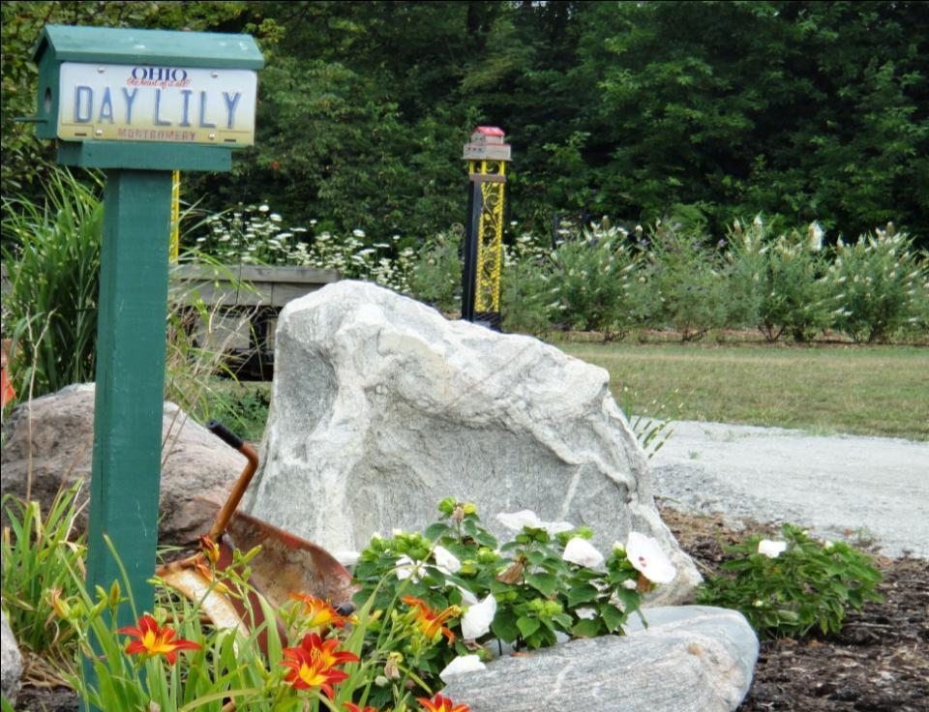
RIVERBEND DAYLILY GARDEN Mike & Sandy Holmes Xenia, OH 2019 Introductions

Slide 2
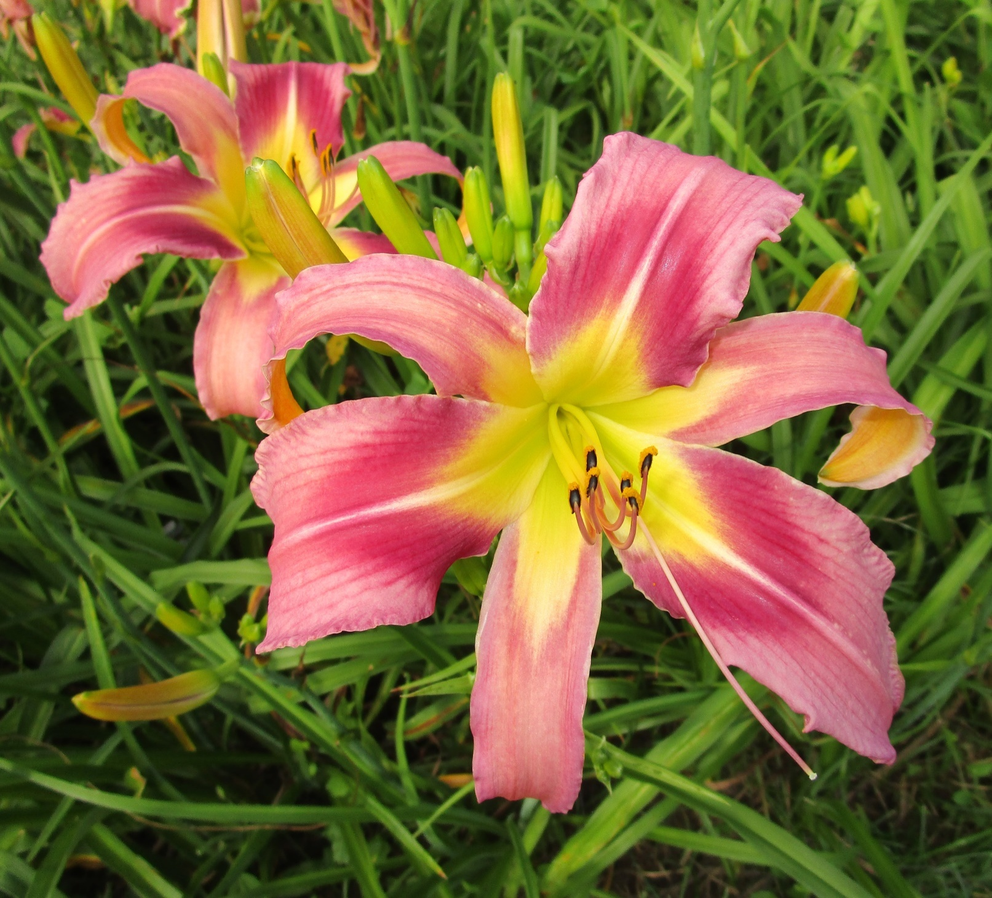
Baby Shark G704
Height 38”
Bloom 7.5”
Ploidy Tet Mid
Foliage Dormant
4 Way 18 Buds

Slide 3
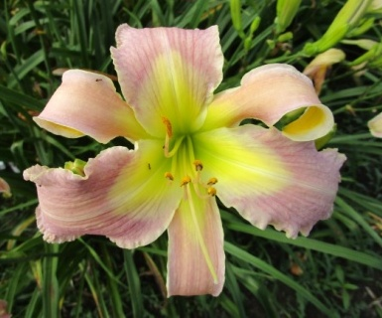
I Get A Round
H234T
Height 38”
Bloom 7”
Ploidy Tet Mid
Foliage Semi
5 Way 20 Buds

Slide 4
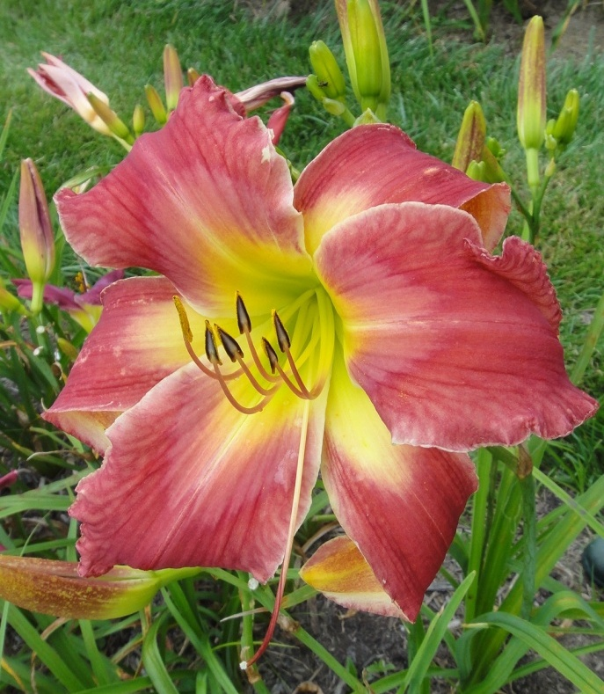
HELP ME RHONDA G711
Height 38”
Bloom 8” Early
Ploidy Tet
Foliage Dormant
3 Way 14 Buds
11” Wingspan

Slide 5
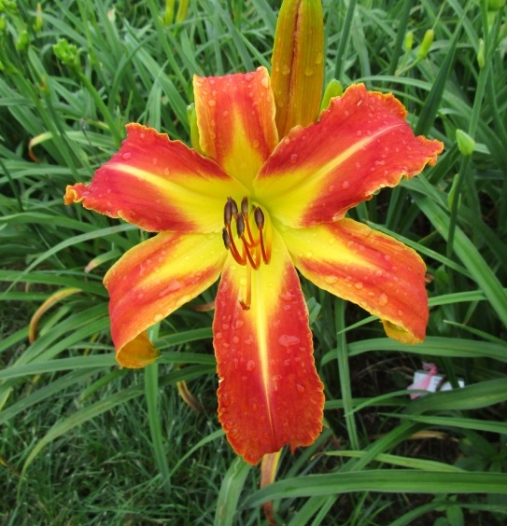
Rainy Days & Mondays G664
Height 44”
Bloom 7.5”
Ploidy Tet
Foliage Semi
3 Way
14 Buds
10” Wingspan

Slide 6
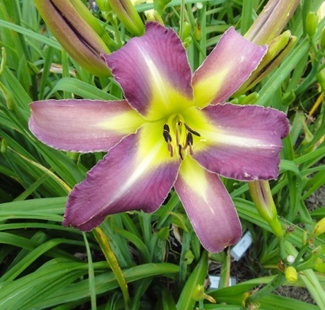
ED’s PURPLE RAIN G1189B
Height 36”
Bloom 6.5”
Ploidy Tet Mid
Foliage Dormant
3 Way 14 Buds

Slide 7
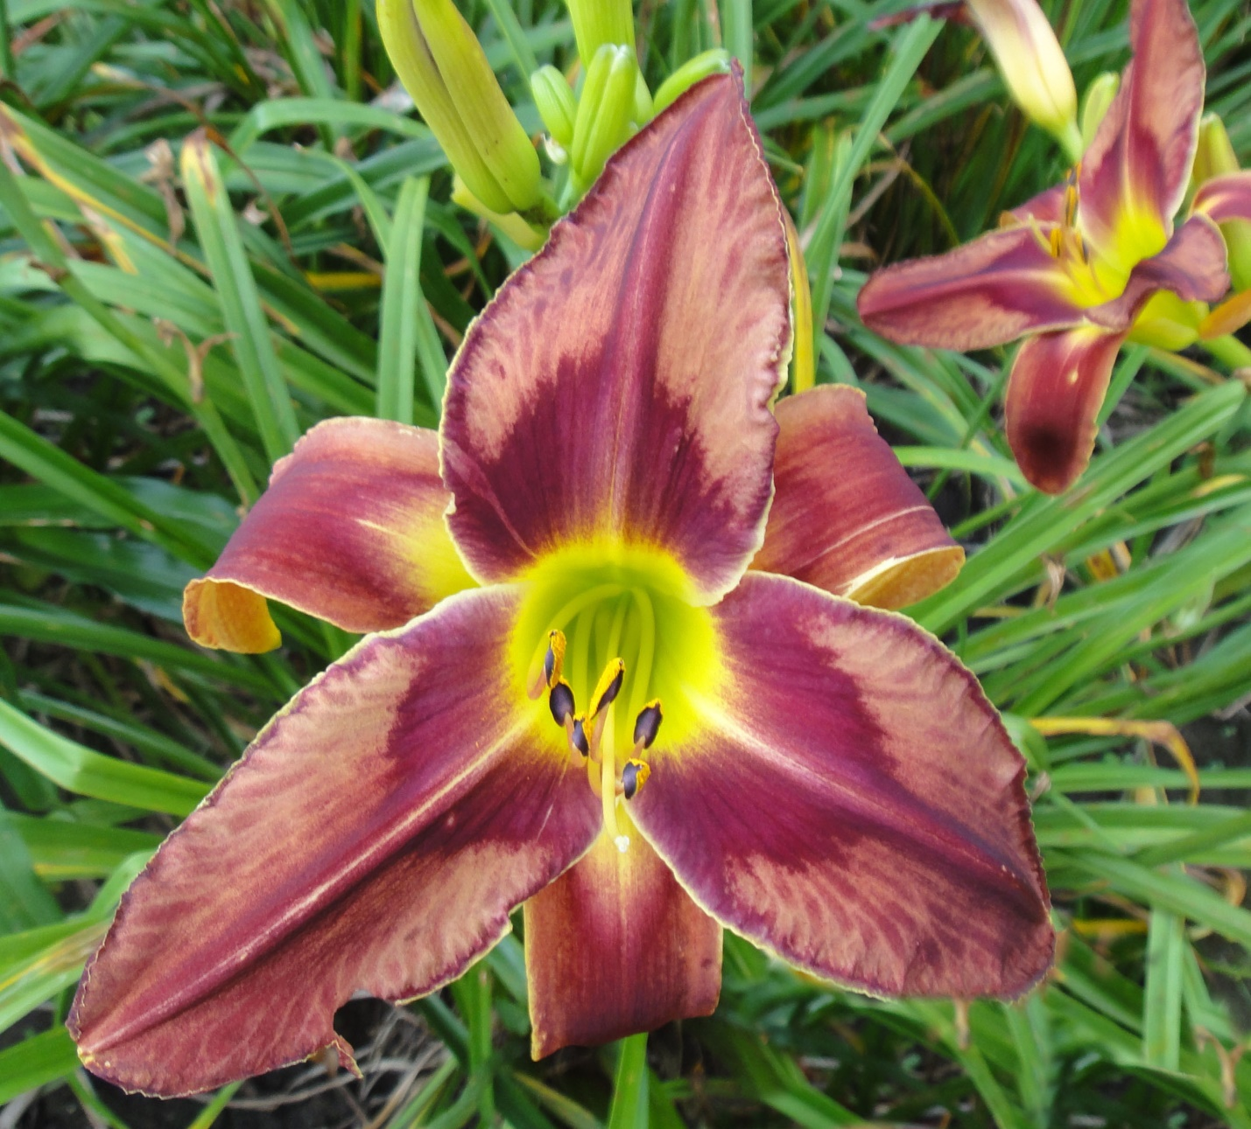
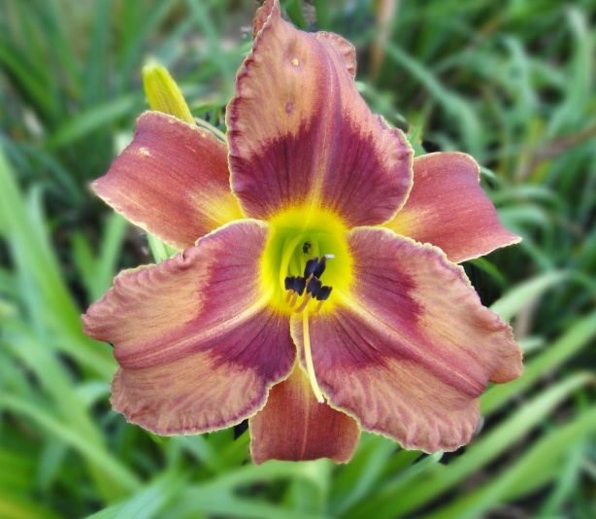
Hazy Shade of Winter D624
Height 36”
Bloom 5.5”
Ploidy Tet Mid
Foliage Dormant
4 Way 18 Buds

Slide 8
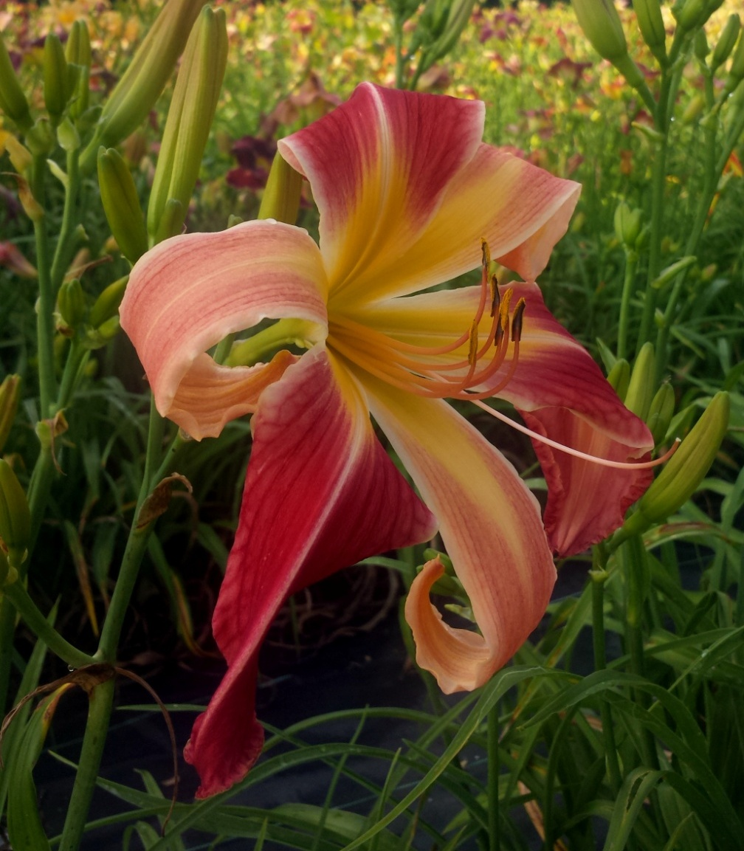
MOWER KING J1302
Height 40”
Bloom 8” Early
Ploidy Tet
Foliage Dormant
3 Way 14 Buds
11” Wingspan

Slide 9
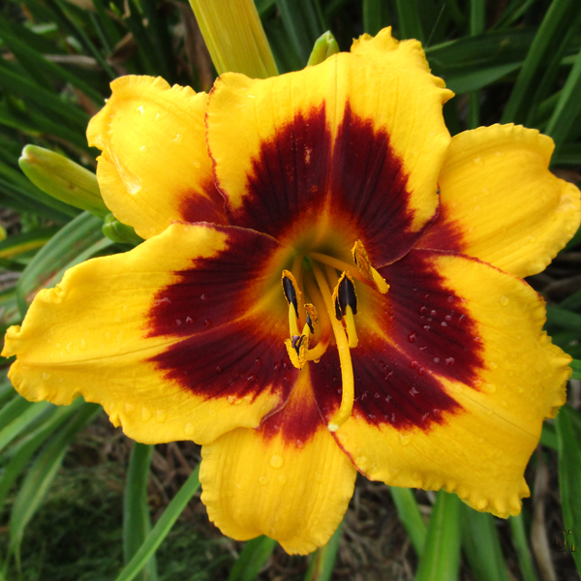
JESTER VAUGHN G2022
Height 36”
Bloom 6”
Ploidy Tet
Foliage Dormant
Mid
5 Way 20 Buds
Rebloom

Slide 10
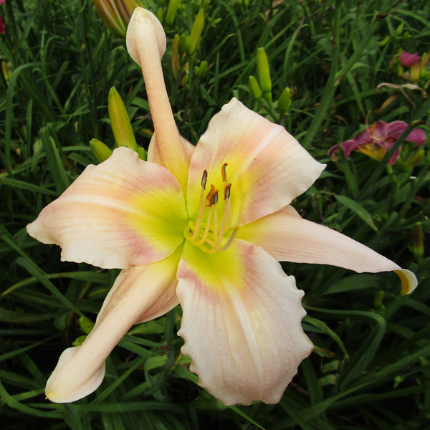
DANCING IN THE CLOUDS SD311H
Height 39”
Bloom 8.5”
Ploidy Tet
Foliage Dormant
4 Way 16 Buds
Rebloom

Slide 11
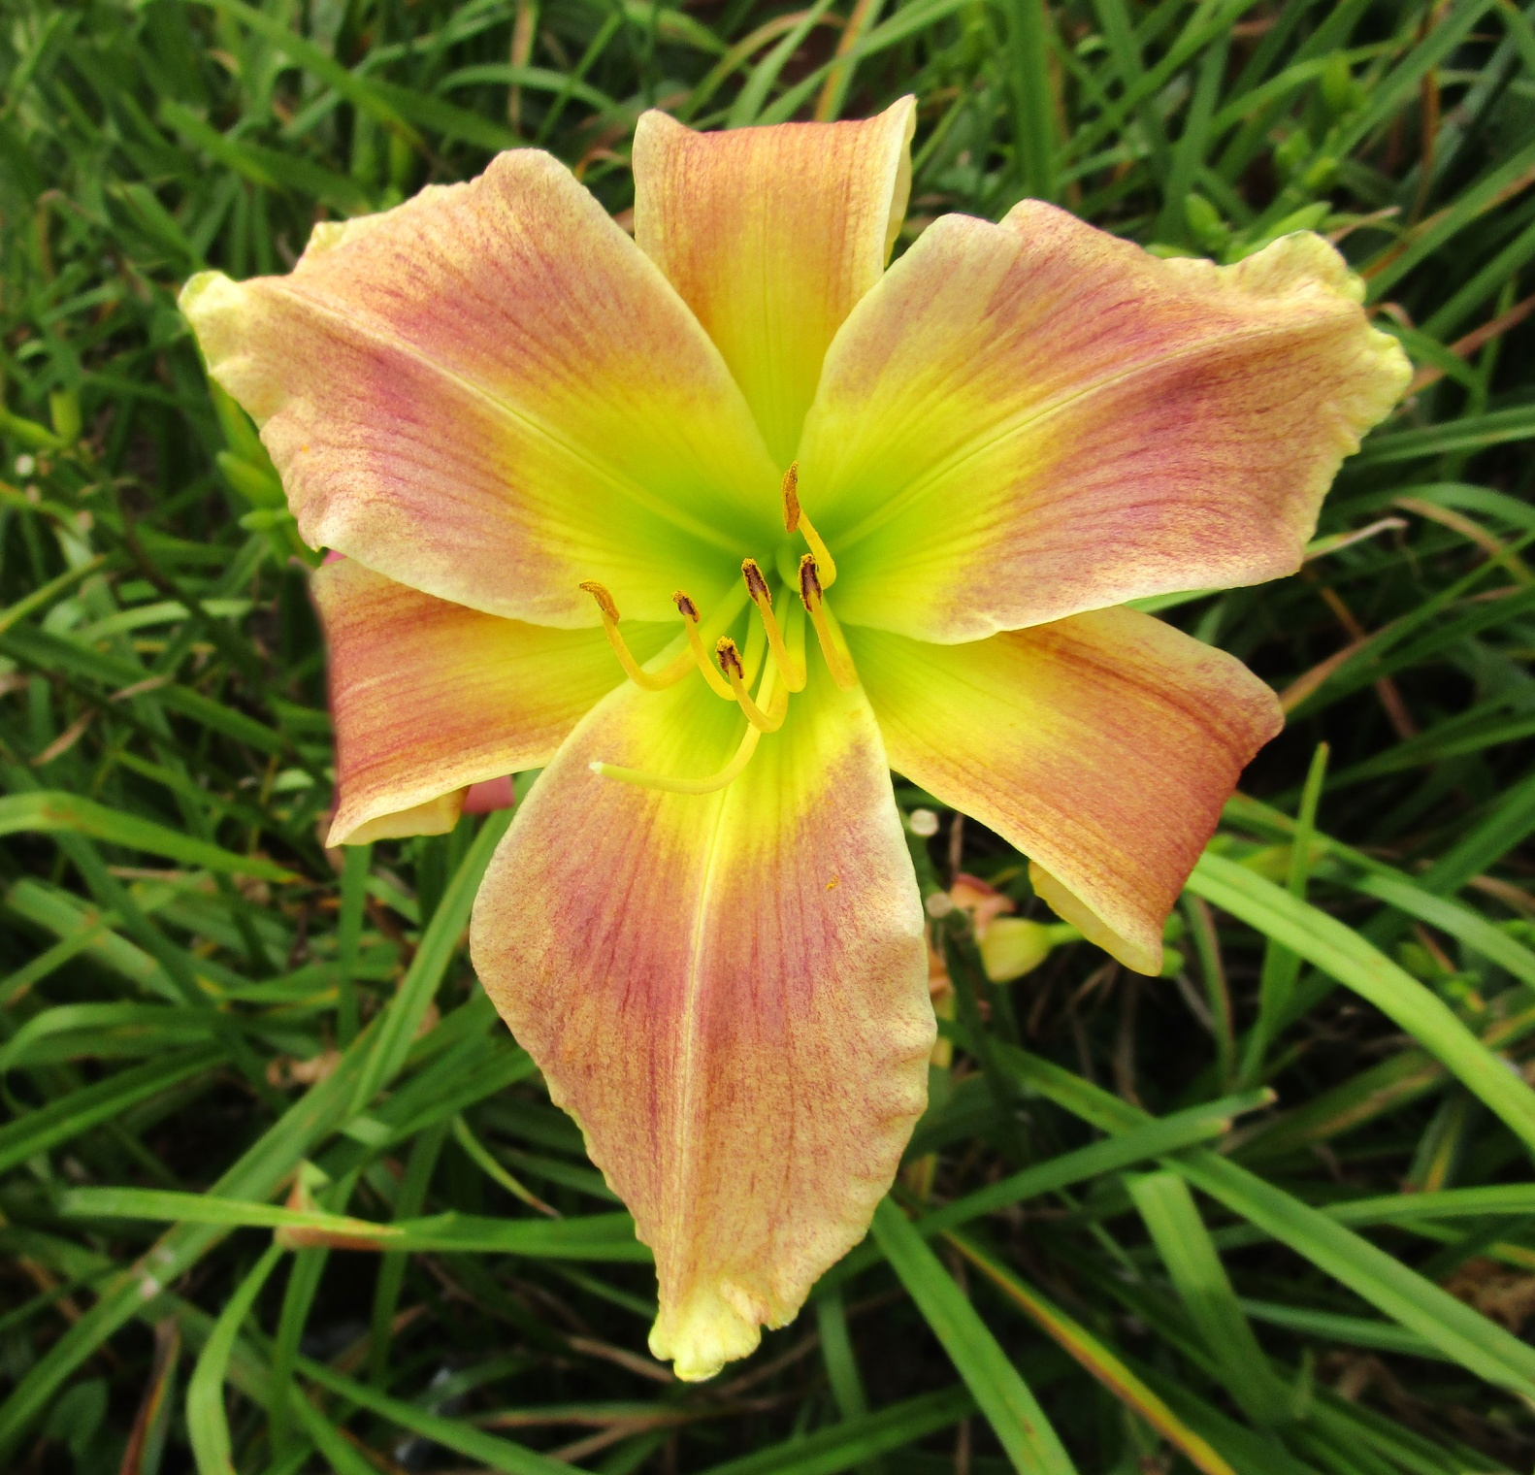
DAPPLED DRAGONG2064
Height 37”
Bloom 6”
Ploidy Tet Mid
Foliage Dormant
4 Way 18 Buds

Slide 12
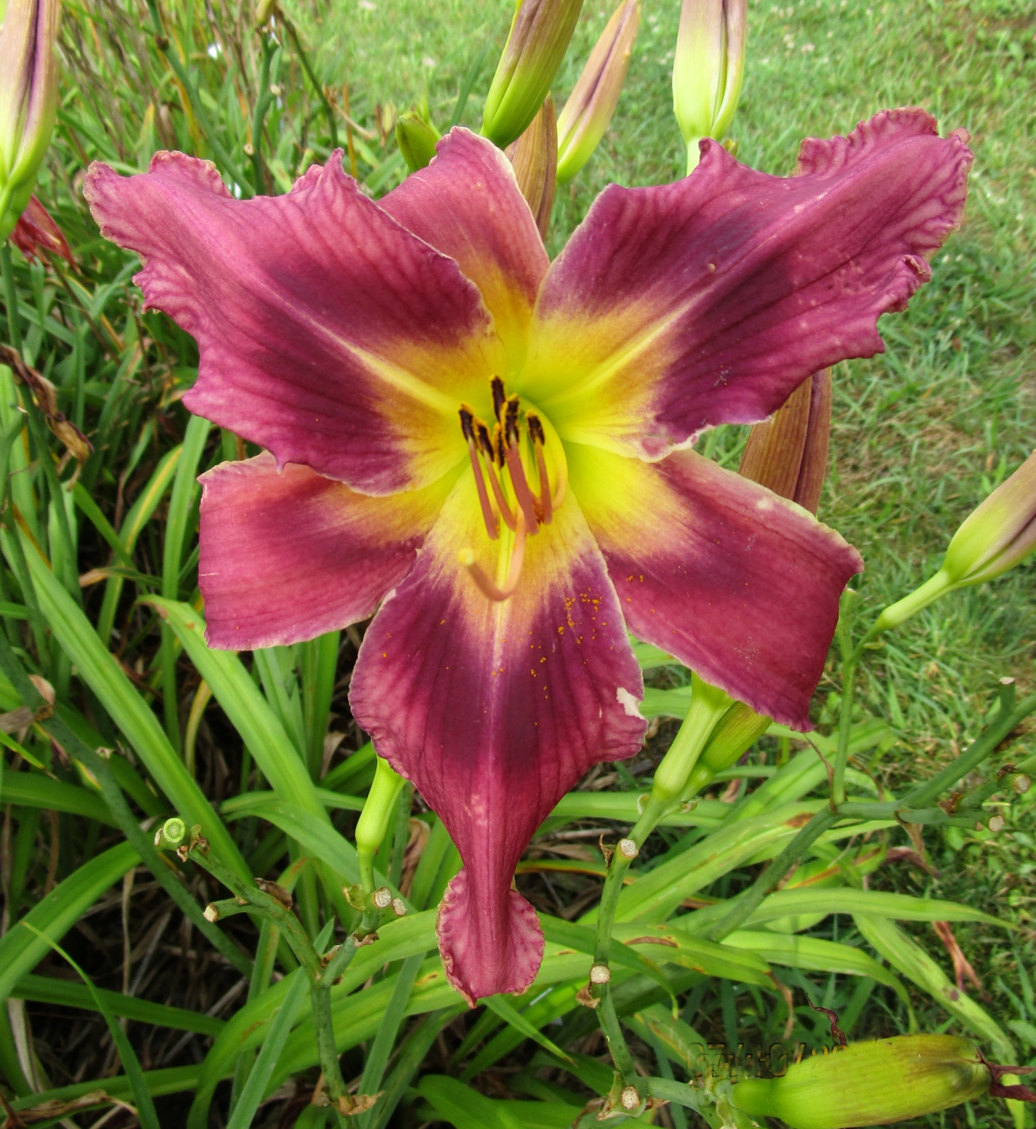
FAR AWAY TREKKER E239 2-4
Height 37”
Bloom 7.5”
Ploidy Tet Mid
Foliage Dormant
4 Way 18 Buds
9” Wingspan

Slide 13
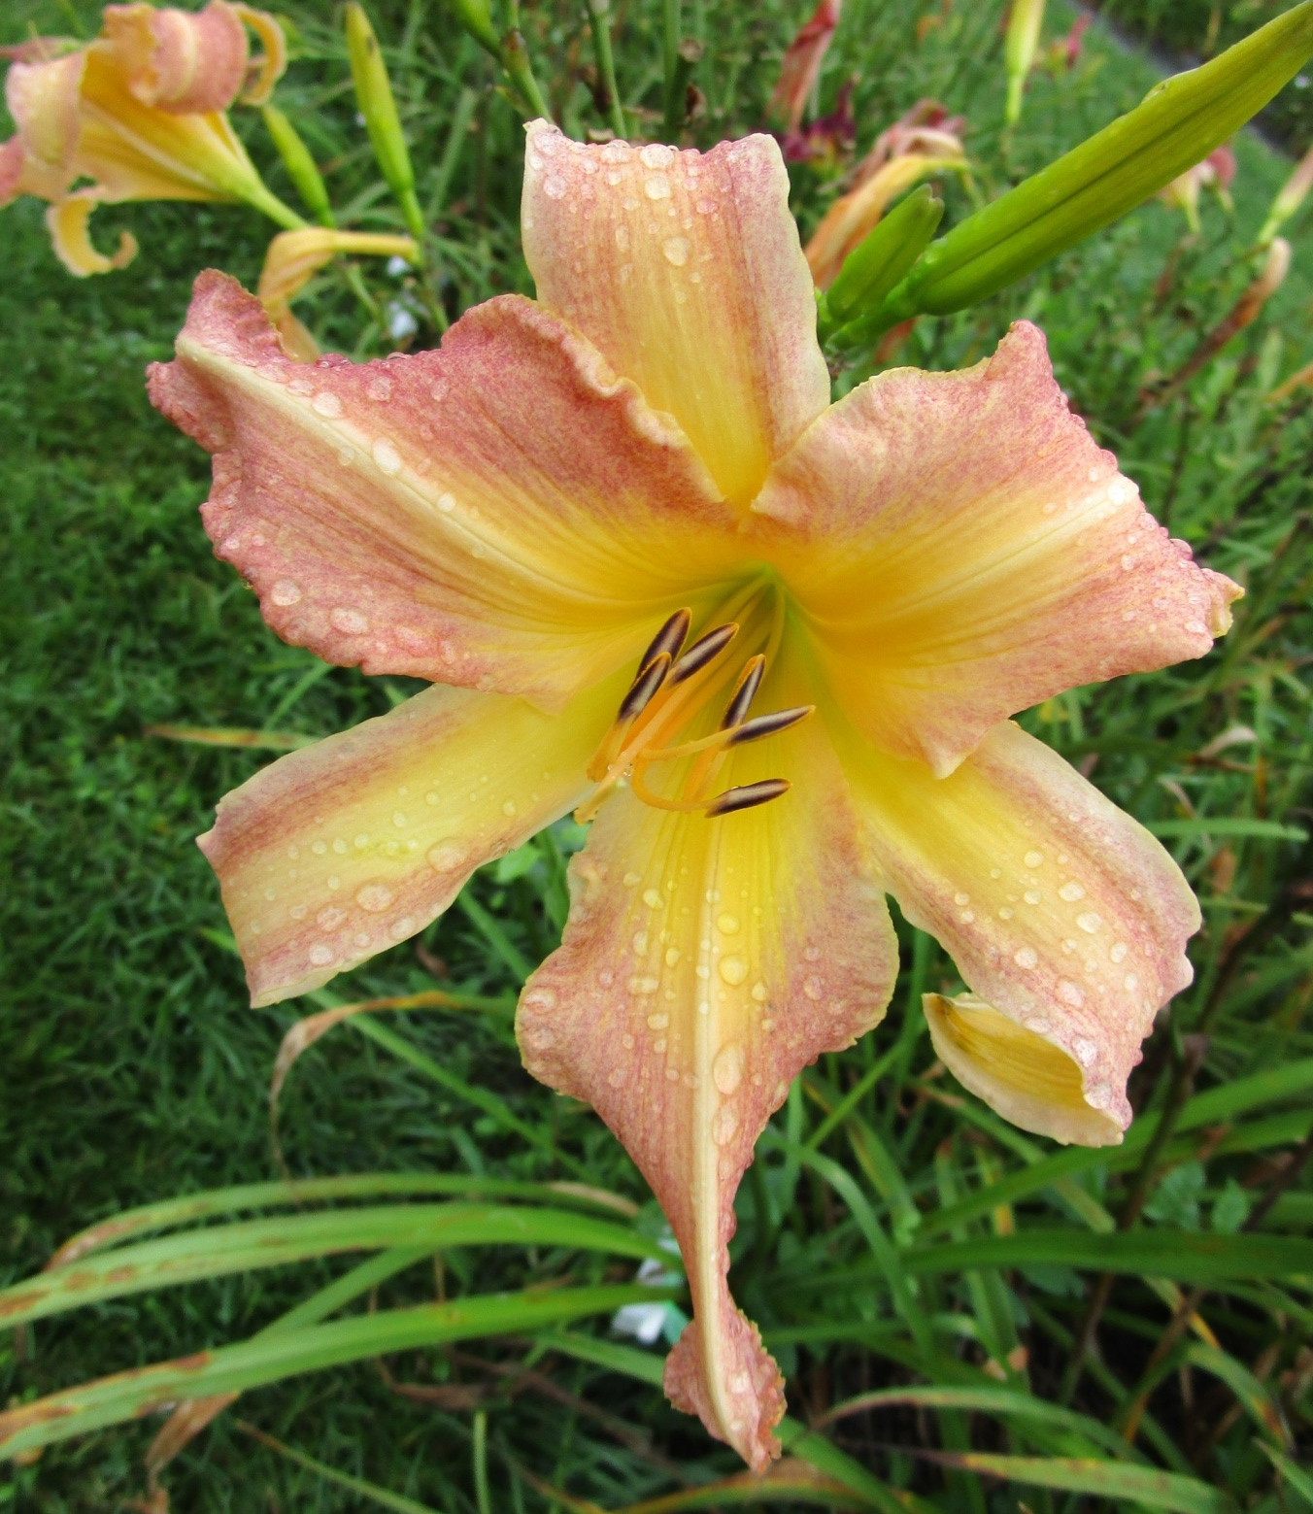
SIR ROY AT THE DOOR H510-1
Height 42”
Bloom 7”
Ploidy Tet Mid
Foliage Semi
5 Way 18 Buds
10” Wingspan

Slide 14
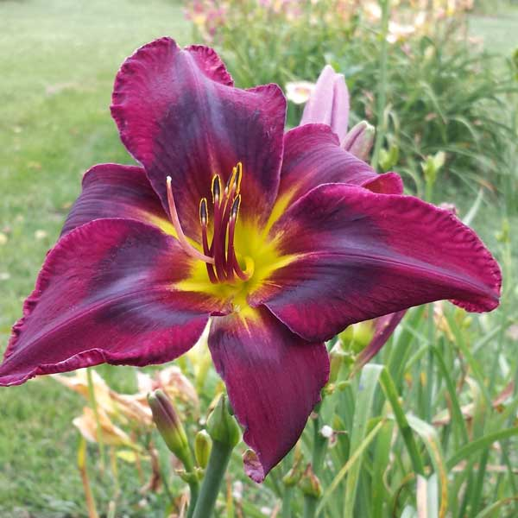
Blackbird Song
Height 38”
Bloom 6.5”
Ploidy Tet
Foliage Dormant
3 Way 16 Buds

Slide 15
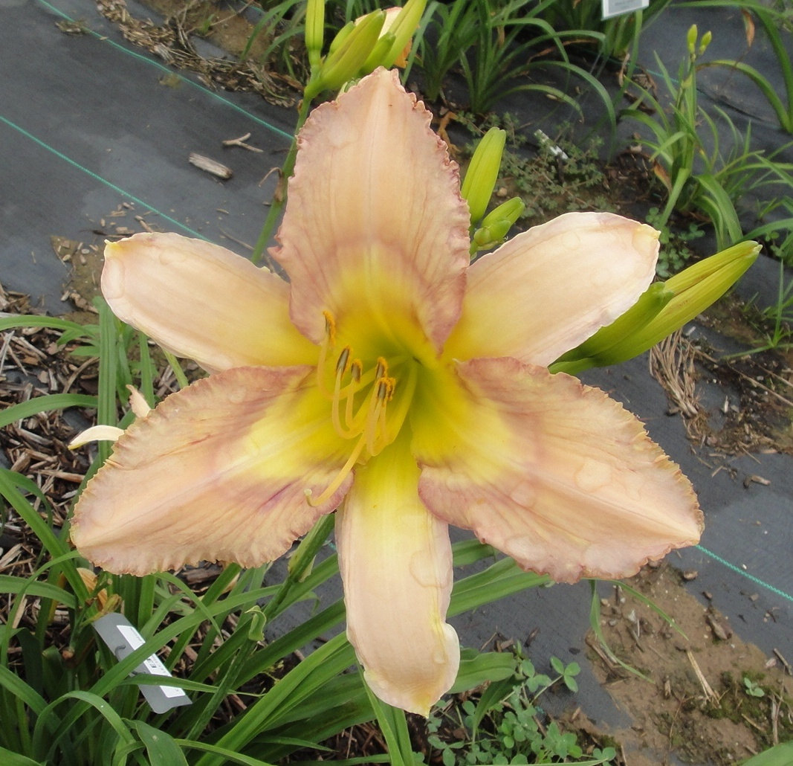
Buddy Wiser
Height 44”
Bloom 6.5”
Ploidy Tet
Foliage Dormant
5 Way 20 Buds

Slide 16
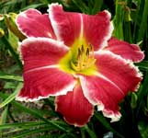
Jack & Shirley
Height 26-30”
Bloom 6.5”
Ploidy Tet
Foliage Semi
3 Way 14 Buds

Slide 17
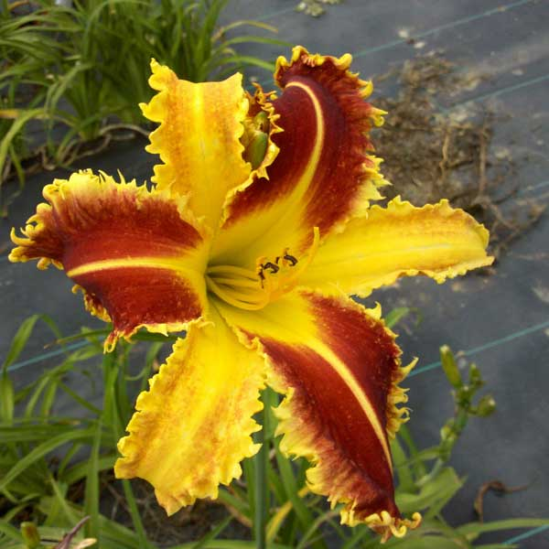
Tracker Jacker
Height 38”
Bloom 7.5”
Ploidy Tet
Foliage Dormant
3 Way 16 Buds

Slide 18
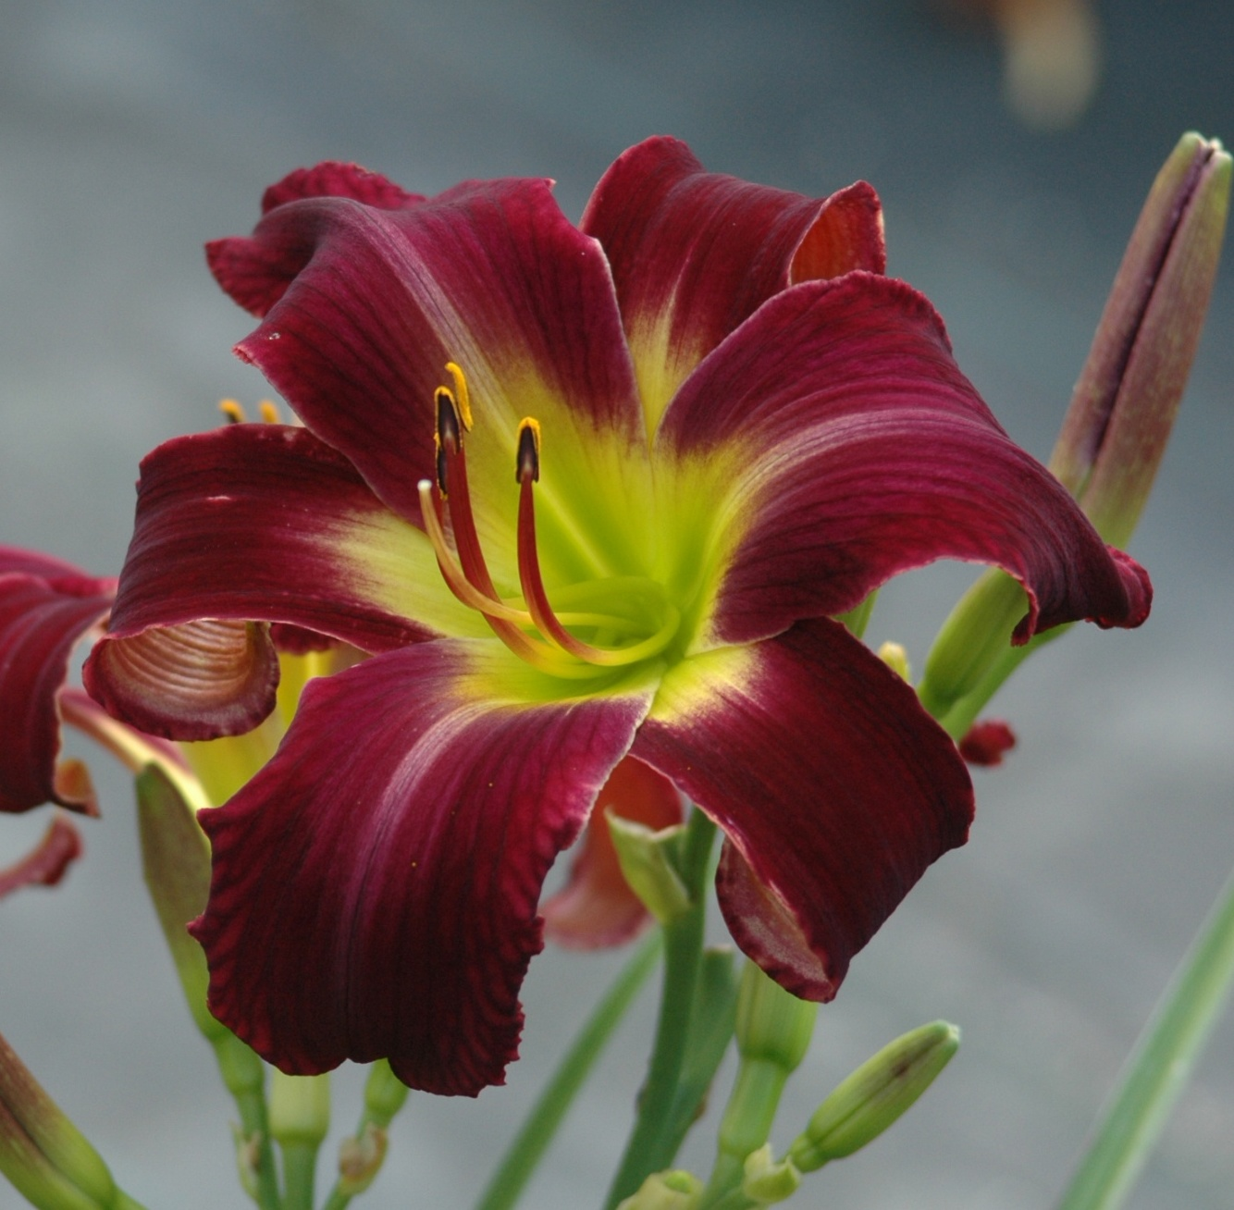
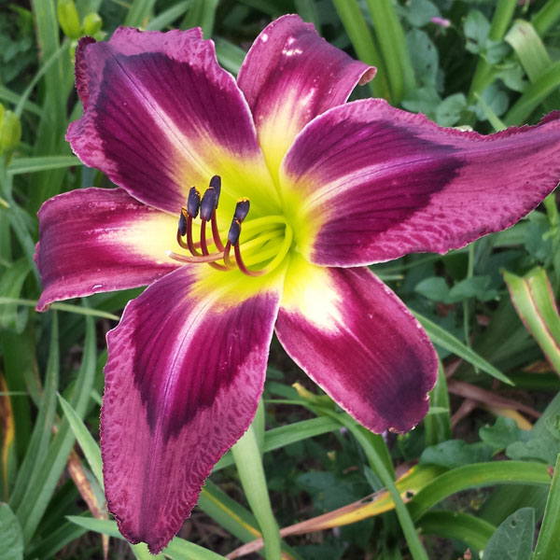
Sweet Chance
Height 36”
Bloom 6.5”
Ploidy Tet
Foliage Semi
4 Way 18 Buds
Warm Weather
Cool Weather

Slide 19
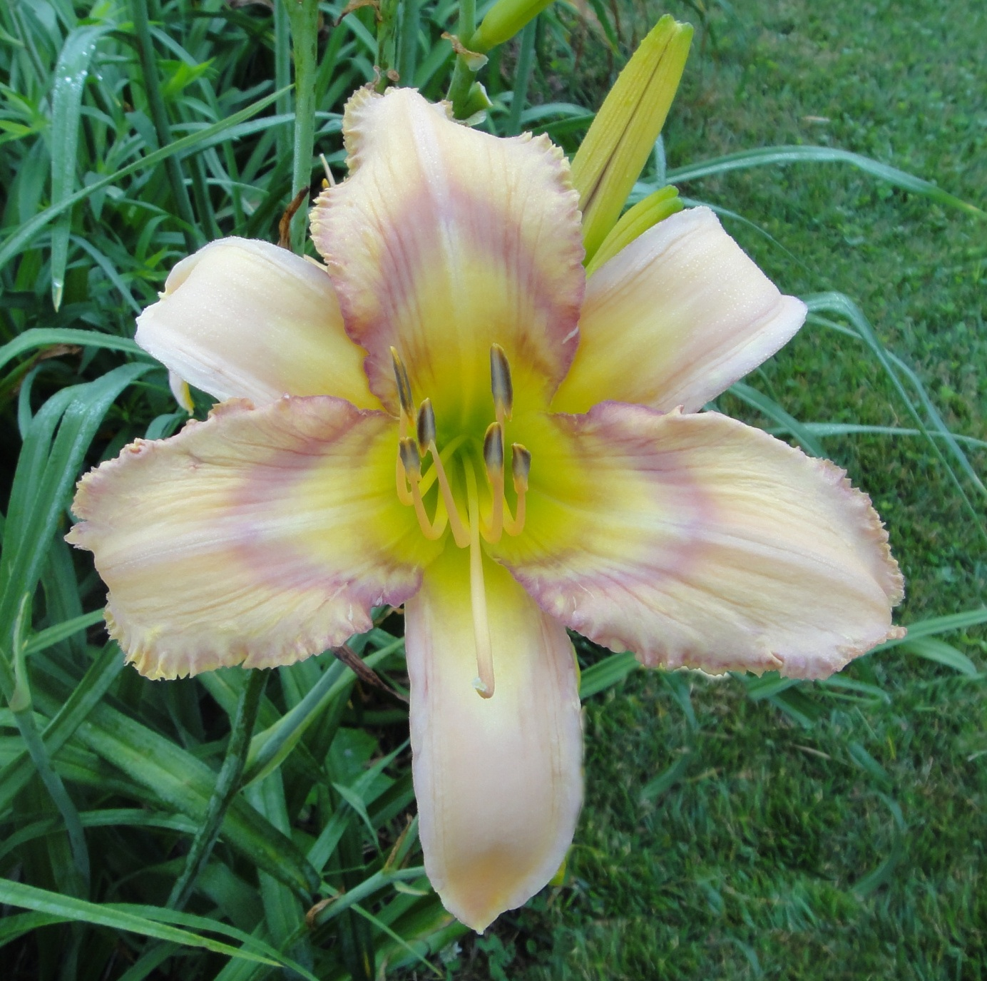
November Sunset
Height 42”
Bloom 6.5”
Ploidy Tet
Foliage Dormant
3 Way 16 Buds

